Slide 1

Organizational Ethics
Chapter 6
©2020 McGraw-Hill Education. All rights reserved. Authorized only for instructor use in the classroom. No reproduction or further distribution permitted without the prior written consent of McGraw-Hill Education.

Slide 2

Corporate Culture and Ethical Climates1
Corporate culture: A blend of ideas, customs, traditional practices, company values, and shared meanings.
Ethical climate: The unspoken understanding among employees of what is and is not acceptable behavior.
Notes:
Corporate culture: A blend of ideas, customs, traditional practices, company values, and shared meanings.
To help define normal behavior for everyone who works in a company.
Nearly twice as many employees observe misconduct by coworkers in weak ethical cultures companies.
Ethical climate: The unspoken understanding among employees of what is and is not acceptable behavior.
Based on the expected standards and norms.
Multiple climates (or subclimates) can exist within one organization.

Slide 3
The Components of Ethical Climates
From Figure 6.1
Copyright © McGraw-Hill Education. Permission required for reproduction or display.
Ethical Criteria | Focus of Individual Person | Organization | Society
Egoism (self-centered approach) | Self-interest | Company interest | Economic efficiency
Benevolence (concern for-others approach) | Friendship | Team interest | Social responsibility
Principle (integrity approach) | Personal morality | Company rules and procedures | Laws and professional codes

Slide 4
Business Ethics Across Organizational Functions
Business operations can be highly specialized, leading to ethical challenges related to those functional areas.
  Professional ethical standards may conflict with the ethical standards within the organization.
→ Example of functional areas:
Accounting Ethics
Financial Ethics
Marketing Ethics
Information Technology Ethics
Supply Chain Ethics
Notes:
Business operations can be highly specialized, leading to ethical challenges related to those functional areas.
Professional ethical standards may conflict with the ethical standards within the organization.
Accounting Ethics Critically important component of every business firm.
Financial records must be audited by a certified professional accounting firm.
Requirements of the accounting function:
Responsibilities.
Public interest.
Integrity.
Objectivity and independence.
Due care.
Conflict of interest
Conflict with self-interest (of the accounting firm) and the interests of others (shareholders and the public).

Slide 5
Business Ethics Across Organizational Functions
Business operations can be highly specialized, leading to ethical challenges related to those functional areas.
  Professional ethical standards may conflict with the ethical standards within the organization.
→ Example of functional areas:
Accounting Ethics
Financial Ethics
Marketing Ethics
Information Technology Ethics
Supply Chain Ethics
Notes:
Financial Ethics Responsibilities to manage the firm’s assets and raising capital.
Example of ethical issues:
Barclays PLC was accused of fraud.
The Royal Bank of Scotland scandal.
Self-regulation as the best path for ethical compliance.

Slide 6
Business Ethics Across Organizational Functions
Business operations can be highly specialized, leading to ethical challenges related to those functional areas.
  Professional ethical standards may conflict with the ethical standards within the organization.
→ Example of functional areas:
Accounting Ethics
Financial Ethics
Marketing Ethics
Information Technology Ethics
Supply Chain Ethics
Notes:
Marketing Ethics
Marketing: advertising, distributing, and selling products or services.
Issues in marketing ethics emphasize honesty and transparency in advertising.
Example: Outcome Health misled their customers.
American Marketing Association (AMA) code of ethics:
Do no harm.
Foster trust.
Embrace ethical values.

Slide 7
Business Ethics Across Organizational Functions
Business operations can be highly specialized, leading to ethical challenges related to those functional areas.
  Professional ethical standards may conflict with the ethical standards within the organization.
→ Example of functional areas:
Information Technology Ethics
Accounting Ethics
Financial Ethics
Marketing Ethics
Supply Chain Ethics
Notes:
Information Technology Ethics
Ethical challenges in this field involve:
Invasions of privacy.
The collection and storage of, and access to, personal and business information.
Confidentiality of electronic mail communication.
Copyright protection regarding software, music, and intellectual property.
Cyberbullying.
→ Example: Vtech collected personal information from children without parental consent.

Slide 8
Business Ethics Across Organizational Functions
Business operations can be highly specialized, leading to ethical challenges related to those functional areas.
  Professional ethical standards may conflict with the ethical standards within the organization.
→ Example of functional areas:
Supply Chain Ethics
Accounting Ethics
Financial Ethics
Marketing Ethics
Information Technology Ethics
Notes:
Supply Chain: production and operations functions needed to create a product or service.
Issues in supply chain ethics emphasize integrity, value and loyalty in business dealings.
Example: Kobe Steel Limited misled their customers.
Institute for Supply Management (ISM) principles and standards:
Avoid impropriety.
Be responsible.
Protect confidentiality.
Follow the law.

Slide 9
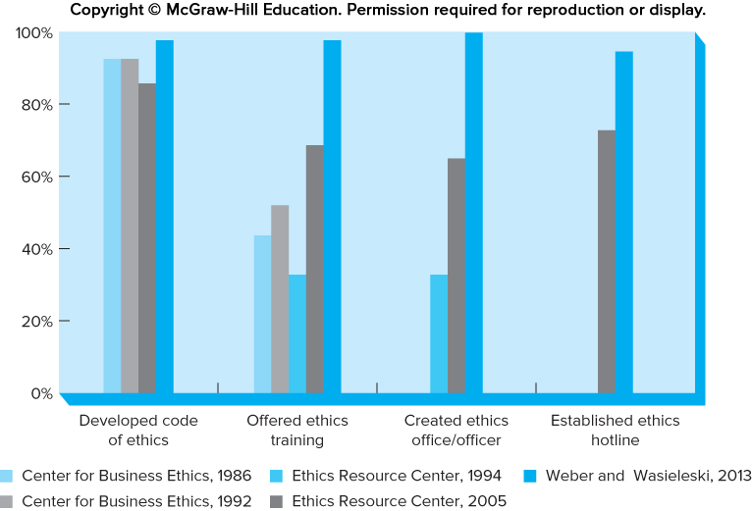
Organizations’ Ethics Safeguards
Percentage of Firms Reporting They Have Ethical Safeguards
Figure 6.2
Copyright © McGraw-Hill Education. Permission required for reproduction or display.
Access the text alternative for these images.
Notes:
Building Ethics Safeguard Into the Company
To improve the quality of a company’s ethical performance you have to change the culture so that ethics is part of everyday decision-making.
To do so means institutionalizing ethics or building ethics safeguards in to everyday routines.

Slide 10

Two Ethics Approaches
Compliance-based approach
Integrity-based approach
Notes:
Two Ethics Approaches
Compliance-based approach:
Seeks to avoid legal sanctions.
Emphasizes the threat of detection and punishment.
Integrity-based approach:
Combines concern for law with employee responsibility.
Promotes acting with integrity and conduct business with honesty and fairness.
Both approaches have been found to lessen unethical conduct, but in somewhat different ways.

Slide 11
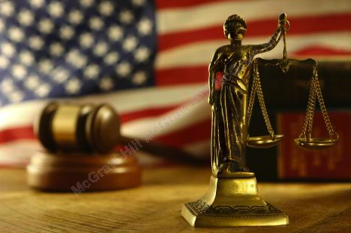
Ethics Programs and Policies1
Top Management Commitment and Involvement
Ethics Policies or Codes
Ethics and Compliance Officers
Ethics Reporting Mechanisms
Ethics Training Programs
Notes:
Top Management Commitment and Involvement:
Critical to fostering employee ethical behavior.
Ethics Policies or Codes:
As a guidance to managers and employees to solve ethical dilemma.
In U.S. policies tend to be instrumental, providing rules and procedures.
In Japan policies tend to be combination of legal compliance and company values.
Ethics programs must be widely distributed and associated with ethics training.
→Example: 3M’s Code of Conduct.
Ethics and Compliance Officers:
Many created as early as the 1980s.
Membership in professional association, Ethics and Compliance Officers Association (ECOA), doubled between 2000 and 2004.
Recently ECOA and Ethics Resource Center merged into the Ethics Compliance Alliance.
Ethics Reporting Mechanisms:
Often called the “helpline” or “hotline.”
Purposes:
To provide interpretations of proper ethical behavior.
To create avenue for reporting unethical conduct.
To provide information-sharing tools for employees and stakeholders.
Executives tend to use the helpline more often than middle managers.
Ethics Training Programs:
Generally the most expensive and time-consuming element of an ethics program.
Found regularly in larger business organizations.
Small and medium businesses are more likely to offer training in alignment with regulatory guidelines.
Example: “Giving Voice to Values” program.

Slide 12
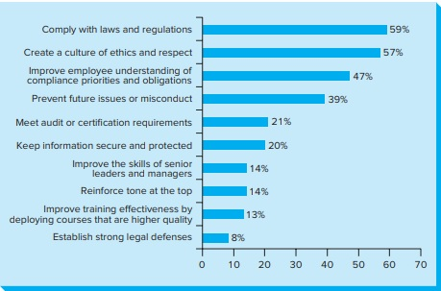
Ethics Programs and Policies4
Objectives and Motivations for Employee Ethics Training Programs
Figure 6.3
Copyright © McGraw-Hill Education. Permission required for reproduction or display.
Access the text alternative for these images.

Slide 13
The World’s Most Ethical Companies
Forbes Magazine’s most ethical companies and their industries
From Figure 6.4
Copyright © McGraw-Hill Education. Permission required for reproduction or display.
These firms were ranked among the highest ethical firms each year from 2007 through 2017.
AFLAC | Insurance
Deere and Company | Industrial manufacturing
Ecolab | Chemicals
Fluor Corporation | Engineering
General Electric | Diversified
International Paper | Paper products
Kao Corporation | Consumer products
Milliken & Company | Industrial manufacturing
PepsiCo | Food & beverage
Starbucks Coffee Company | Restaurants
Texas Instruments | Computers
UPS | Transportation
Xerox | Computers

Slide 14

Ethics in a Global Economy
Doing business in global context brings up host of complex ethical challenges:
  Bribery
  Dow Jones Anti-Corruption Survey
  Numerous efforts to prohibit bribery:
Notes:
Doing business in global context brings up host of complex ethical challenges.
Bribery: a questionable or unjust payment often to a government official to ensure or facilitate a business transaction.
International watchdog agency, Transparency International, publishes a survey of countries’ levels of corruption.
Bribe-taking more likely in countries with low per capita income, low salaries for government officials, and less income variation.
Dow Jones Anti-Corruption Survey
Seventy-one percent of respondents stopped or delayed business dealings with corrupt partners.
Numerous efforts to prohibit bribery:
U.S. Foreign ­Corrupt Practices Act (FCPA).
The United Kingdom’s Bribery Act prohibits bribery.
Anti-Bribery Law in Brazil, India and Mexico.
Organization’s culture and ethical work climate play a central role in encouraging employees to act ethically.

Slide 15
Organizational Ethics
Chapter 6
©2020 McGraw-Hill Education. All rights reserved. Authorized only for instructor use in the classroom. No reproduction or further distribution permitted without the prior written consent of McGraw-Hill Education.

